Slide 1
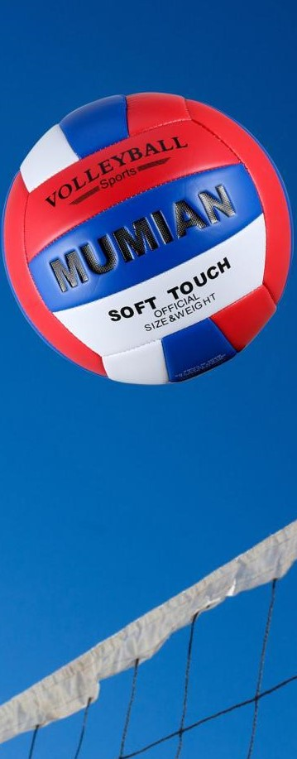
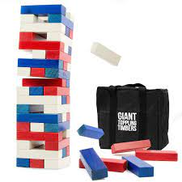
Westside High School
Feb.20-24 Week At a Glance (WAG)

Slide 2
Coach Thomas
Rec. Games: Feb.20-24

Slide 3
Monday - Agenda
Learning Target
I can use proper technique for stretching
I can use strategy to compete in relay while also working as a team
Feb 20
Standard:
Opening ( 10-15 mins)
Student will go through stretches with coaches lead
Work-session ( 20 - 25 mins)
Review of station/circuit exercises & students will go 30 seconds for each station
2. Coach will explain rules of speed ball (mix of basketball, soccer, and football)
(those not participating will walk)
Criteria for Success
1. Students can use proper technique to perform exercises
Closing ( 05 – 10 mins)
Cool down

Slide 4
Tuesday - Agenda
Learning Target
Feb 21 Standard:
PERG.1 The physically educated student demonstrates competency in a variety of motor skills and movement patterns.
a. Demonstrates competence while performing skills in a variety of recreational game settings and activities
b. Performs skills at a level of competence, which contributes to health-related fitness.
c. Demonstrates proper warm-up and cool-down protocol associated with different life time
sport physical activities.
PERG. 2 The physically educated student applies the knowledge of concepts, principles, strategies, and tactics related to movement and performance.
Integrates a variety of strategies, tactics, concepts, and skills during recreational games activities
Evaluates skills needed for recreational games and leisure activities
PERG.3 The physically educated student demonstrates knowledge and skills to help achieve
and maintain a health-enhancing level of physical activity and fitness.
a. Maintains or improves fitness level by using the results of the Georgia Fitness Assessment
to guide changes in a personal program of physical activity.
b. Uses technologies to assess, enhance, and maintain health-related and skill-related fitness.
c. Analyzes the relationship between physical activity and longevity.
Personal and Social Behavior, Rules, Safety, and Etiquette
I can use the proper techniques to do the following
-stretch, complete circuit exercises,
2. I can compete as a team and follow game rules of speed ball
Opening ( 10-15 mins)
5-10 minute static & dynamic stretches (5 minutes locker rooms)
Work-session ( 20 - 25 mins)
30 seconds each exercise circui
Teacher will provide rules of speed ball and students will work together as teams to compete
Criteria for Success
Students are able to use team strategy to compete in game of speed ball
Closing ( 05 – 10 mins)
locker room unlocked for 5 minutes
-students use remaining time to cool down & rehydrate if necessary

Slide 5
Wednesday - Agenda
Learning Target
Feb. 22 Standard:
PERG.1 The physically educated student demonstrates competency in a variety of motor skills and movement patterns.
a. Demonstrates competence while performing skills in a variety of recreational game settings and activities
b. Performs skills at a level of competence, which contributes to health-related fitness.
c. Demonstrates proper warm-up and cool-down protocol associated with different life time
sport physical activities.
PERG. 2 The physically educated student applies the knowledge of concepts, principles, strategies, and tactics related to movement and performance.
Integrates a variety of strategies, tactics, concepts, and skills during recreational games activities
Evaluates skills needed for recreational games and leisure activities
PERG.3 The physically educated student demonstrates knowledge and skills to help achieve
and maintain a health-enhancing level of physical activity and fitness.
a. Maintains or improves fitness level by using the results of the Georgia Fitness Assessment
to guide changes in a personal program of physical activity.
b. Uses technologies to assess, enhance, and maintain health-related and skill-related fitness.
c. Analyzes the relationship between physical activity and longevity.
Personal and Social Behavior, Rules, Safety, and Etiquette
I can use the proper technique for curl ups
I can use the proper technique for push ups
I can push myself to do my very best for each exercise for assessing my fitness level
Opening ( 10-15 mins)
Static & Dynamic Stretches
Work-session ( 20 - 25 mins)
Coach will review the technique and expectations for each exercise and call students by names to complete fitness gram exercises: curl ups & push ups
Students will perform fitness gram exercises using the proper technique
Criteria for Success
Closing ( 05 – 10 mins)
Students will use the proper technique to perform fitness gram exercises
-curl ups
-push ups
-locker room unlocked for 5 minutes
-students use remaining time to cool down & rehydrate if necessary

Slide 6
Thursday - Agenda
Learning Target
Same as Tuesday & Wednesday
Feb. 23 Standard:
PERG.1 The physically educated student demonstrates competency in a variety of motor skills and movement patterns.
a. Demonstrates competence while performing skills in a variety of recreational game settings and activities
b. Performs skills at a level of competence, which contributes to health-related fitness.
c. Demonstrates proper warm-up and cool-down protocol associated with different life time
sport physical activities.
PERG. 2 The physically educated student applies the knowledge of concepts, principles, strategies, and tactics related to movement and performance.
Integrates a variety of strategies, tactics, concepts, and skills during recreational games activities
Evaluates skills needed for recreational games and leisure activities
PERG.3 The physically educated student demonstrates knowledge and skills to help achieve
and maintain a health-enhancing level of physical activity and fitness.
a. Maintains or improves fitness level by using the results of the Georgia Fitness Assessment
to guide changes in a personal program of physical activity.
b. Uses technologies to assess, enhance, and maintain health-related and skill-related fitness.
c. Analyzes the relationship between physical activity and longevity.
Personal and Social Behavior, Rules, Safety, and Etiquette
Opening ( 10-15 mins)
Static & Dynamic stretching
Work-session ( 20 - 25 mins)
Same as previous day
Those that did not complete the pacer test will use today as a make-up day
IF time permits, students will be allowed to free play
Criteria for Success
Closing ( 05 – 10 mins)
Same as previous day
-locker room unlocked for 5 minutes
-students use remaining time to cool down & rehydrate if necessary

Slide 7
Friday - Agenda
Learning Target
Feb. 24 Standard:
PERG.1 The physically educated student demonstrates competency in a variety of motor skills and movement patterns.
a. Demonstrates competence while performing skills in a variety of recreational game settings and activities
b. Performs skills at a level of competence, which contributes to health-related fitness.
c. Demonstrates proper warm-up and cool-down protocol associated with different life time
sport physical activities.
PERG.3 The physically educated student demonstrates knowledge and skills to help achieve
and maintain a health-enhancing level of physical activity and fitness.
a. Maintains or improves fitness level by using the results of the Georgia Fitness Assessment
to guide changes in a personal program of physical activity.
b. Uses technologies to assess, enhance, and maintain health-related and skill-related fitness.
c. Analyzes the relationship between physical activity and longevity.
Personal and Social Behavior, Rules, Safety, and Etiquette
Freestyle Friday
Opening ( 10-15 mins)
Attendance
Work-session ( 20 - 25 mins)
Students are able to engage in various activities/sports typically those that they are most interested
Teacher will conference will students and possibly make parent phone calls/contact as needed
Criteria for Success
I can demonstrate my understanding of the rules, procedures, and expectations by following them during class time and asking questions to teacher if necessary.
Closing ( 05 – 10 mins)
N/A

Slide 8
Resources
https://www.youtube.com/watch?v=az_oouQa6VY

